Slide 1
Weeks 5 & 6 Review
Cindy J. Pang
BIOSTAT 100A Summer Session C 2024
September 11, 2024

Slide 2

Errors in Hypothesis Testing
Type I Error/$α$-Error/Consumer Risk
Type II Error/$β$-Error/ Producer Risk
$β$ depends on:
(1)
(2)
(3)

Slide 3
Two Sample Problems
Goal of Two Sample Problems:
(1)
(2)
Types
1.
2.
Unpaired is more likely to reject but why should we still use a paired test?
Situations where we do matched-pairs in clinical research:
1.
2.

Slide 4
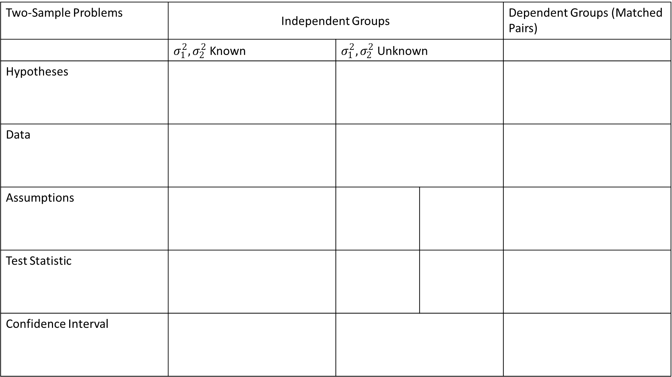
Two-Sample Problems | Independent Groups |  |  | Dependent Groups (Matched Pairs)
 | $σ_{1}^{2}, σ_{2}^{2}$ Known | $σ_{1}^{2}, σ_{2}^{2}$ Unknown
Hypotheses
Data
Assumptions
Test Statistic
Confidence Interval

